Slide 1
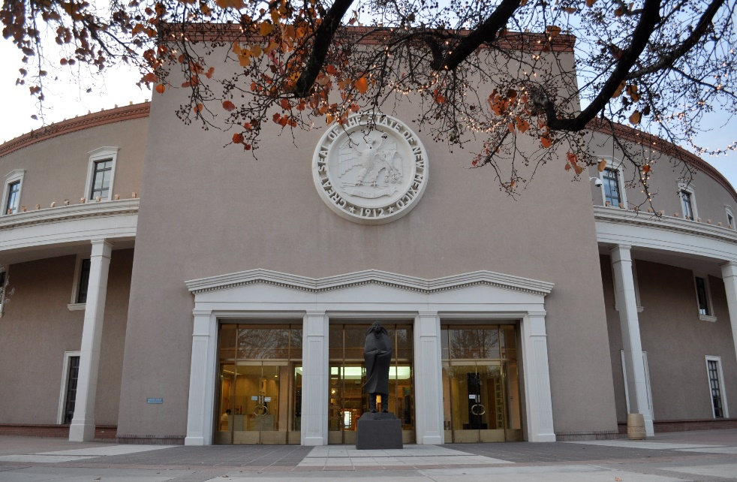
LEGISLATIVE PROCESS and the ROLE OF THE LEGISLATIVE COUNCIL SERVICE New Mexico State Legislature
League of Women Voters
New Mexico
October 12, 2023
Notes:
Good morning … welcome
Thx for invite …
Intro … position … agency …
Personal note … law school in late 40s … policy, not litigation
Boller story … 23 years later … still here …

Slide 2
New Mexico Legislature
Constitution: three co-equal branches of government
Separation of powers – Article 3, NM Constitution
Legislature – Article 4, NM Constitution
Bicameral
House of Representatives – 70 members – Two-year terms
(45 Democrats, 25 Republicans — 2023-2024 biennium)
Senate – 42 members – Four-year terms
(27 Democrats, 15 Republicans — 2023-2024 biennium)
Deliberative process — It’s not just about debate!
Protocols and unwritten rules — Don’t make it personal!
Notes:
Separation of powers – foundational
Each branch must guard against encroachment from the other branches
Need a strong, healthy tension
Deliberativeness: not a synonym for debate (certainly one of its elements). Rather, deliberativeness describes those structures and steps of the legislative process that slow legislative decision making and distance it from the passions and immediacy of the prevailing desires of individual legislators and of various constituencies
Structures and steps: bicameralism (exc. NE) and executive veto (one of the broadest in U.S.)

Slide 3
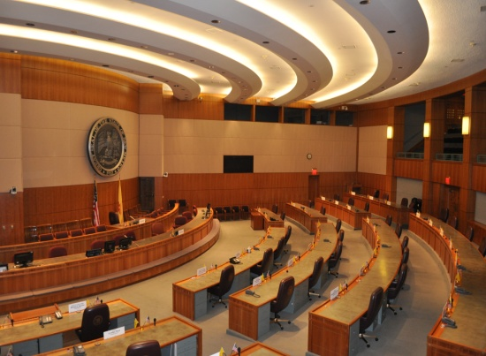
Legislative Sessions
Regular sessions
Odd-numbered years—60 days
Even-numbered years—30 days
Budget, appropriation & revenue bills
Bills with special messages from the governor
Bills of the last previous regular session vetoed by the governor
Special sessions – not to exceed 30 days
Called by the governor – open to items in the proclamation
Extraordinary sessions – not to exceed 30 days
Called by the legislature – open to all purposes
Notes:
Until 1966, 60-day sessions only in odd-numbered years
Biennial budgets … 50s & 60s … special session for budget
CA passed in 1964
30-day sessions in even-numbered years … limited – EXPLAIN
Special – Gov decides
Extraordinary – legislature decides “for all purposes”

Slide 4
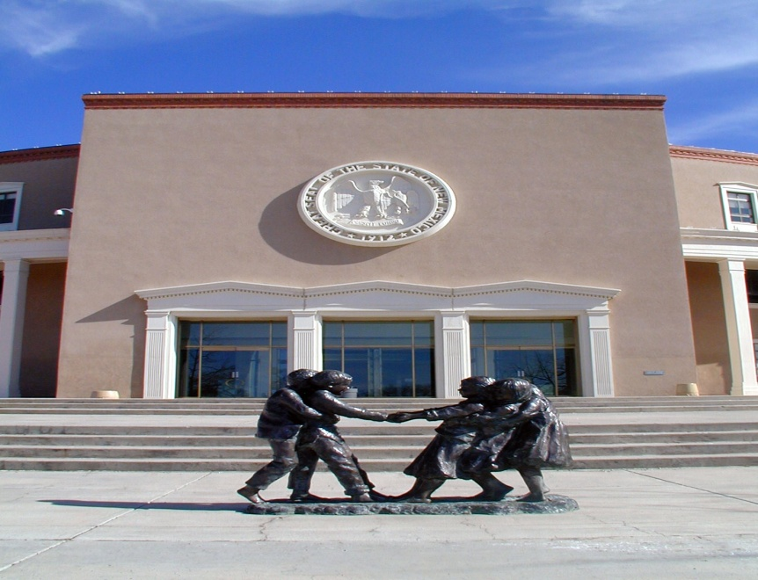
Legislative Council Service
Chapter 2, Article 3 NMSA 1978
Created in 1951
Primary duties in Section 2-3-8 NMSA 1978
Duties expanded significantly since its creation
Bill drafting and legal research
Impartial and accurate information
Document production – not just bill drafting
Capital outlay research, drafting & reports
Interim committee staff
IT – website, webcasts and cybersecurity
General information & assistance
Ethics complaints, impeachment efforts
Care, custody, maintenance and security of the State Capitol
Notes:
Confidentiality & non-partisan (non-advocacy) – 2-3-13
Confidentiality: shall not reveal to any person … the nature or contents of any request … except with the requester’s consent
Non-partisan: shall not urge or oppose any legislation … nor give advice on economic or social effect of legislation, unless asked
Wisconsin Legislative Reference Library 1901 – first of its kind
All bill drafting in 1907
Congressional Research Service modeled on LRL
Name changed to Leg Ref Bureau
Professionalization … modernization …

Slide 5
Nonpartisan and Confidentiality Requirements
Section 2-3-13 NMSA 1978
“Neither the director nor any employee of the council service shall reveal to any person outside of the service the contents or nature of any request or statement for service, except with the consent of the person making such request or statement. They shall not urge or oppose any legislation, nor give to any member of the legislature advice concerning the economic or social effect of any bill or proposed bill except upon the request of such member.”
Confidentiality – Privileges and Immunity (Speech & Debate)
Nonpartisan – Focus on the institution; preserve, protect and promote the institution; “strict regard to the division of powers among the legislative, executive and judicial branches”

Slide 6
Requests for Legislation
Requests can be received from:
Legislators
Executive branch
Judicial branch
Public bodies
Others, with a legislator’s authorization (lobbyists, constituents, advocates)
Types of requests:
Bills, simple or joint memorials, simple or joint resolutions, amendments, substitutes, certificates, memoranda & other documents
What is the problem you are trying to solve?
Mandate? Prohibition? Authorization?
All legislation requires a legislative sponsor
Notes:
Shall, shall not, may
What are you trying to solve?
Context …

Slide 7
Bill Introduction
Sponsor & co-sponsors sign
Chief clerk assigns bill number
Committee assignment
Speaker of the House (no committee limit)
Senate (two-committee limit, not including Senate Finance Committee)
Bills with appropriations are referred to House Appropriations and Finance Committee or Senate Finance Committee
Notes:
Sponsor
Bill #
Committee assignment
Speaker – plenary authority
Senate – through Maj Leader, Lt Gov (Sen Prez) announces, unanimous consent

Slide 8
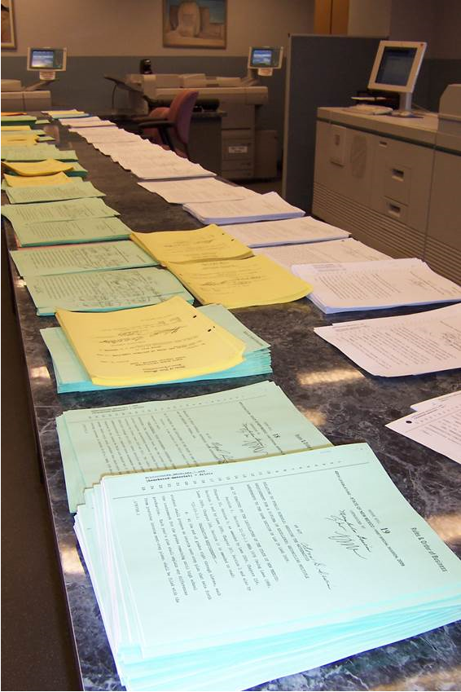
Bills in Committee
Committee action
Hearing date
Public meetings
Legislator presentation & technical expert(s)
Public input
Committee actions:
Amend bill
Substitute bill
Report out with or without recommendation
Requires adoption by House or Senate
Table – action postponed indefinitely (API)
Notes:
Committees – part of the deliberative process
Takes time … years, decades … e.g.,:
Repeal of death penalty
Prohibition on cockfighting
Creation of ethics commission
… “died in committee”

Slide 9
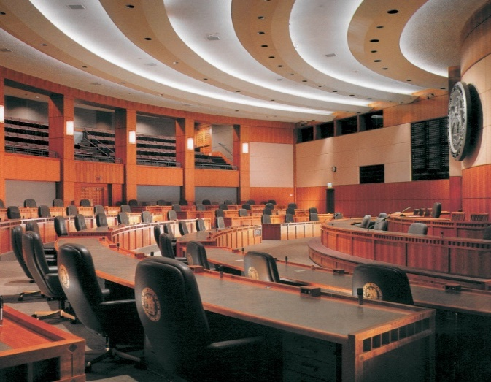
Bill in House or Senate Floor
Committee recommendation presented to entire House or Senate
If adopted, bill is sent to the next committee or placed on the calendar for entire chamber to consider
Subject to debate, amendment or substitution – passage or non-passage
Rules
House
Senate
Joint
Mason’s Manual of Legislative Procedure
Notes:
Committee decision is only rec to entire chamber
Committee is only a part of legislative body
Committee can’t act for the body, can only recommend
Floor debate … 3rd reading … on final passage

Slide 10
Bill to Second Chamber
If passed by first house, sent to next house and process begins again
Committee, floor, votes and associated actions
Passed in second house without amendment
Enrolled and engrossed in house of origin and sent to governor
Passed in second house with amendments
Sent to the house of origin for concurrence
If no concurrence, request other house to recede from its amendments
If no concurrence and no agreement to recede, then to conference committee
Substitute bills - treated like a new bill and must go through a new committee referral process in the other chamber
Notes:
More deliberative process …
Bicameral …
Note: sometimes, conflict isn’t just D vs R … often it’s House vs. Senate … and in NM, urban vs. rural is significant conflict
2nd house can amend or sub a bill
If amended in 2nd house, concurrence in 1st
If substituted in 2nd house, new bill in 1st

Slide 11
Bill to Governor
If a bill passes both houses, it goes to the governor
If received before the last three days of the session, the governor has three days to sign or veto with objections; otherwise, the bill becomes law
If received during or after the last three days of the session, the governor has twenty days to act on the bill or it is “pocket vetoed”
Veto override
Bill language cannot change
Same session
During same biennial legislature
Notes:
Timing
Before last 3 days of session … 3 days to act WITH OBJECTIONS
Previous governor … 10 bills returned without objection, legislature challenged, supreme court declared bills were law for lack of objection
Broadest veto power in U.S. … part or parts, item or items … but needs to be whole of the part or parts … can’t strike a digit, i.e., Gov Mtz struck the digit 1 out of $150,000 to change it to a $50,000 appropriation

Slide 12
What Governs the Legislature?
New Mexico Constitution
Article 4
Court cases
Statutes
Chapter 2, NMSA 1978
House Rules
Senate Rules
Joint Rules
Mason’s Manual of Legislative Procedure
Legislative Council Policies
Legislative Council Service
Chapter 2, Article 1, NMSA 1978
Legislative Finance Committee
Chapter 2, Article 5, NMSA 1978
Legislative Education Study Committee
Chapter 2, Article 10, NMSA 1978
Interim Activities of the House and Senate Chief Clerks
Chapter 2, Article 14, NMSA 1978
Feed Bill – HB 1
Annual appropriations for the legislature
Notes:
Left – specific to legislature and its members
Rules – process & procedure
Can help minority
Can help anyone who understand them well
If you have any political geekiness in you, highly recommend any of the four books on LBJ by Robert Caro, especially Master of the Senate
Right – specific to legislative agencies
Feed bill … because it feeds the legislature … % of entire state budget?
Ultimately, the people govern the legislature through elections … first branch of gov’t listed in each state’s constitution and in federal constitution

Slide 13
Legislative Publications & Resources
Bill Locators (by bill, legislator, subject)
Bills as introduced, amendments & final version
Highlights
Pros & Cons – constitutional amendments
Piecemeal Amendment of the Constitution of New Mexico
Legislative agency studies & reports
Interim committee handouts & information
Biennial Report of the Legislative Council and the Legislative Council Service
Legislative library
Webcasting of committee & floor sessions
National Conference of State Legislatures (NCSL)
Council of State Governments (CSG)
Notes:
Website
Legislative library
Website … nmlegis.gov … 505.986.4600

Slide 14
Legislative Interim Activities
Legislative Council
Legislative Council Service
Interim committees
Over 20 study and oversight committees, task forces, commissions and subcommittees
Legislative Finance Committee
General Appropriations Act
Program evaluation
Legislative Education Study Committee
K-12 education policy & planning oversight
House and Senate Chief Clerks
Constituent Services
Notes:
LC – speaks for leg when not in session
LCS – admin art of LC and legislature … drafting, legal research, leg library, accounting, IT, print shop,
Professionalization of legislatures began last century
WI – legislative reference bureau
Many states followed
NM in 1951

Slide 15
2024 – Second Session of the 56th Legislature
January 2 – January 12
January 16
January 31
February 15
March 6
May 15
Legislation may be prefiled
Opening day (noon)
Deadline for introduction
Session ends (noon)
Legislation not acted upon by governor is pocket vetoed
Effective date of legislation not a general appropriation bill or a bill carrying an emergency clause or other specified date

Slide 16
Representative democracy
"For those ... who may yet be burdened by ... apprehensions concerning the legislature and the exercise of its broad discretionary powers, there should be the gentle reminder that the first step on the road to totalitarianism has always been the destruction of the representative branch. The representative branch, whatever may be the merits of the newer devices of democracy, remains the foundation of responsible government".
- Dick Folmar, former assistant director of the LCS
Notes:
20 seconds to read …
Can’t emphasize this enough
Focus … media, social media, public … is on the executive – the governor or the president
Legislatures – congress or state legislatures have the power … the power of the purse … the power to investigate … the power to set policy for the state … the power to impeach and try public officials … plenary power
Yes, it’s messy, not pretty, two things you don’t want to see being made – sausage and laws
Winston Churchill … paraphrasing … democracy is the worst form of government, except for everything else that’s been tried …

Slide 17
Thank you!
Raúl E. Burciaga, Esq.
Director
Legislative Council Service
505-986-4671 (o)
505-944-6383 (c)
raul.burciaga@nmlegis.gov
www.nmlegis.gov
Notes:
Visit leg during session

